Slide 1

Linear Algebra
Vectors, vector spaces, matrices, coordinates, and transformations
Yordan Darakchiev
Technical Trainer
iordan93@gmail.com

Slide 2
sli.do #MathForDevs

Slide 3
Table of Contents
Vectors
Geometric and algebraic perspectives
Operations
Matrices
Definition
Properties
Operations
Linear transformations
Linear systems

Slide 4
Vectors
Concrete and abstract

Slide 5

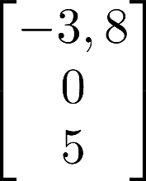
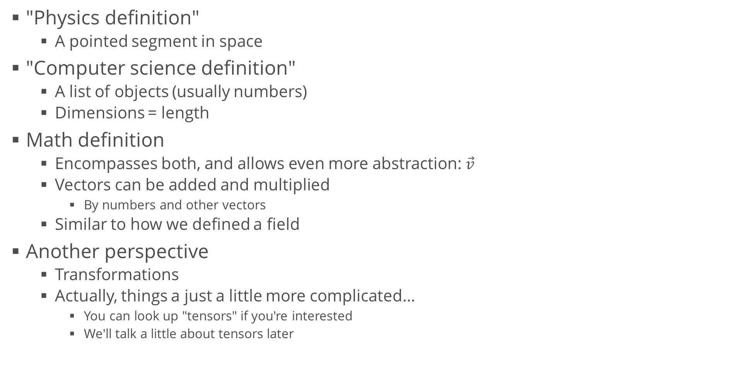
Vector Definitions
"Physics definition"
A pointed segment in space
"Computer science definition"
A list of objects (usually numbers)
Dimensions = length
Math definition
Encompasses both, and allows even more abstraction: $\vec{v}$
Vectors can be added and multiplied
By numbers and other vectors
Similar to how we defined a field
Another perspective
Transformations
Actually, things a just a little more complicated…
You can look up "tensors" if you're interested
We'll talk a little about tensors later

Slide 6
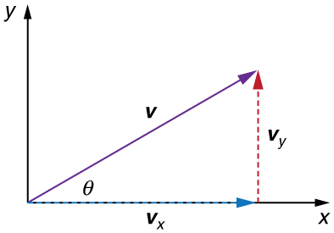

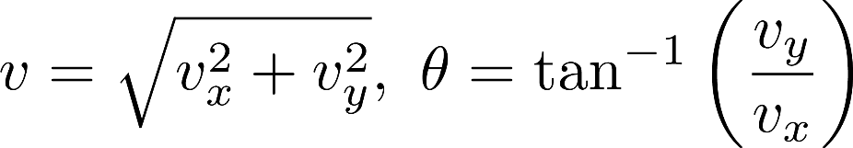
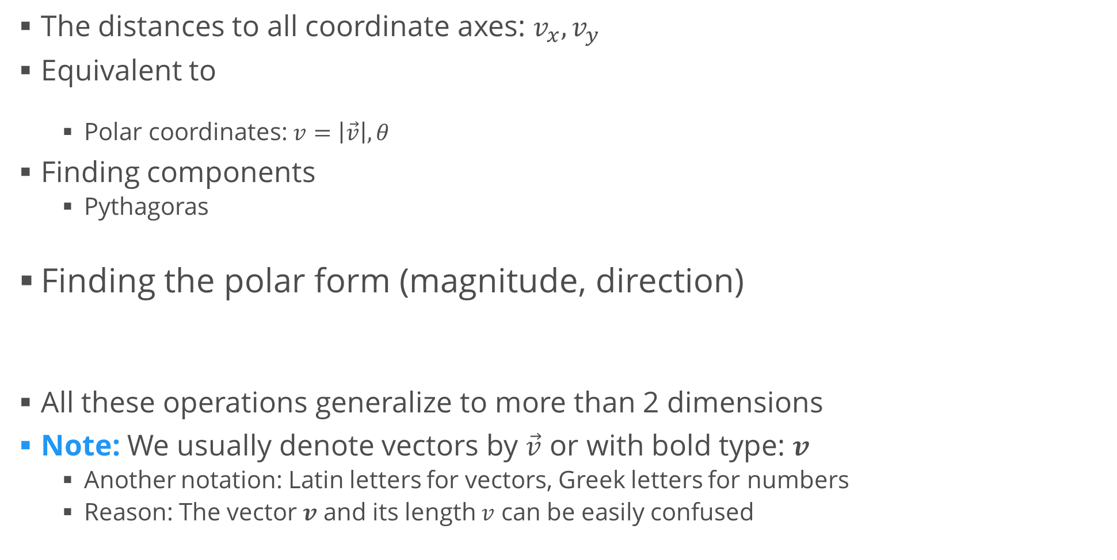
Vector Components
The distances to all coordinate axes: $v_{x}, v_{y}$
Equivalent to
Polar coordinates: $v=\left|\vec{v}\right|, θ$
Finding components
Pythagoras
Finding the polar form (magnitude, direction)
All these operations generalize to more than 2 dimensions
Note: We usually denote vectors by $\vec{v}$ or with bold type: $v$
Another notation: Latin letters for vectors, Greek letters for numbers
Reason: The vector $v$ and its length $v$ can be easily confused

Slide 7
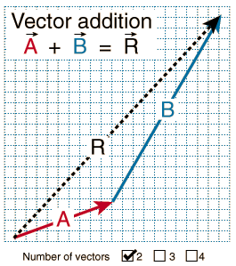
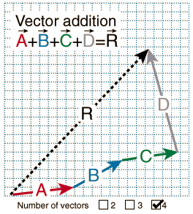
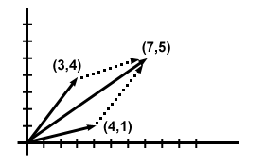
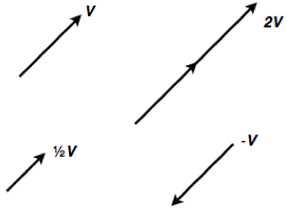
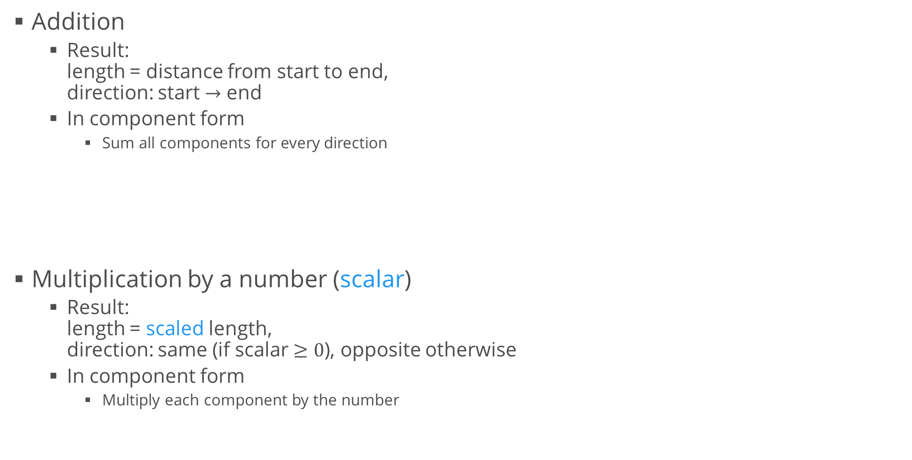
Vector Operations
Addition
Result: length = distance from start to end, direction: start $→$ end
In component form
Sum all components for every direction
Multiplication by a number (scalar)
Result: length = scaled length, direction: same (if scalar $≥0$), opposite otherwise
In component form
Multiply each component by the number

Slide 8
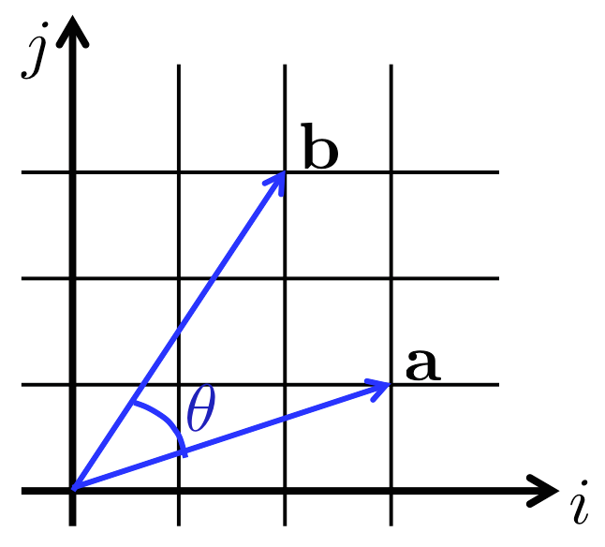

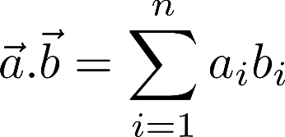
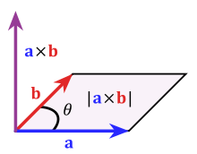

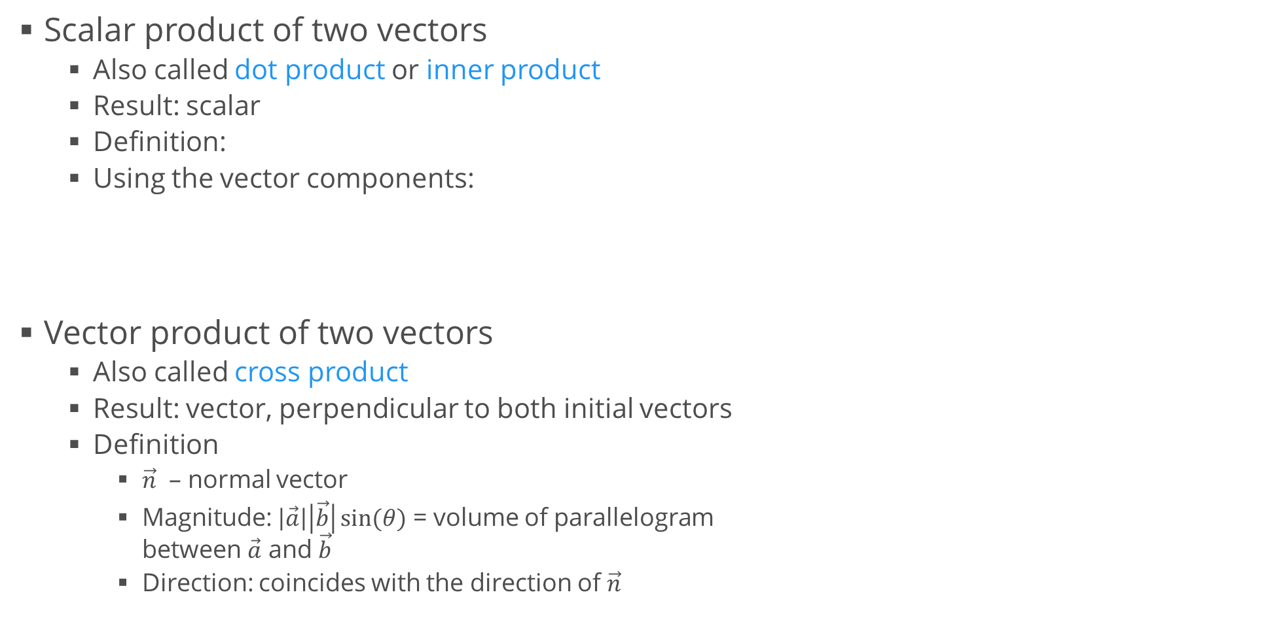
Vector Operations (2)
Scalar product of two vectors
Also called dot product or inner product
Result: scalar
Definition:
Using the vector components:
Vector product of two vectors
Also called cross product
Result: vector, perpendicular to both initial vectors
Definition
$\vec{n}$ – normal vector
Magnitude: $\left|\vec{a}\right|\left|\vec{b}\right|\sin{(θ)}$ = volume of parallelogram between $\vec{a}$ and $\vec{b}$
Direction: coincides with the direction of $\vec{n}$

Slide 9
Vector Spaces
Finding yourself in space

Slide 10





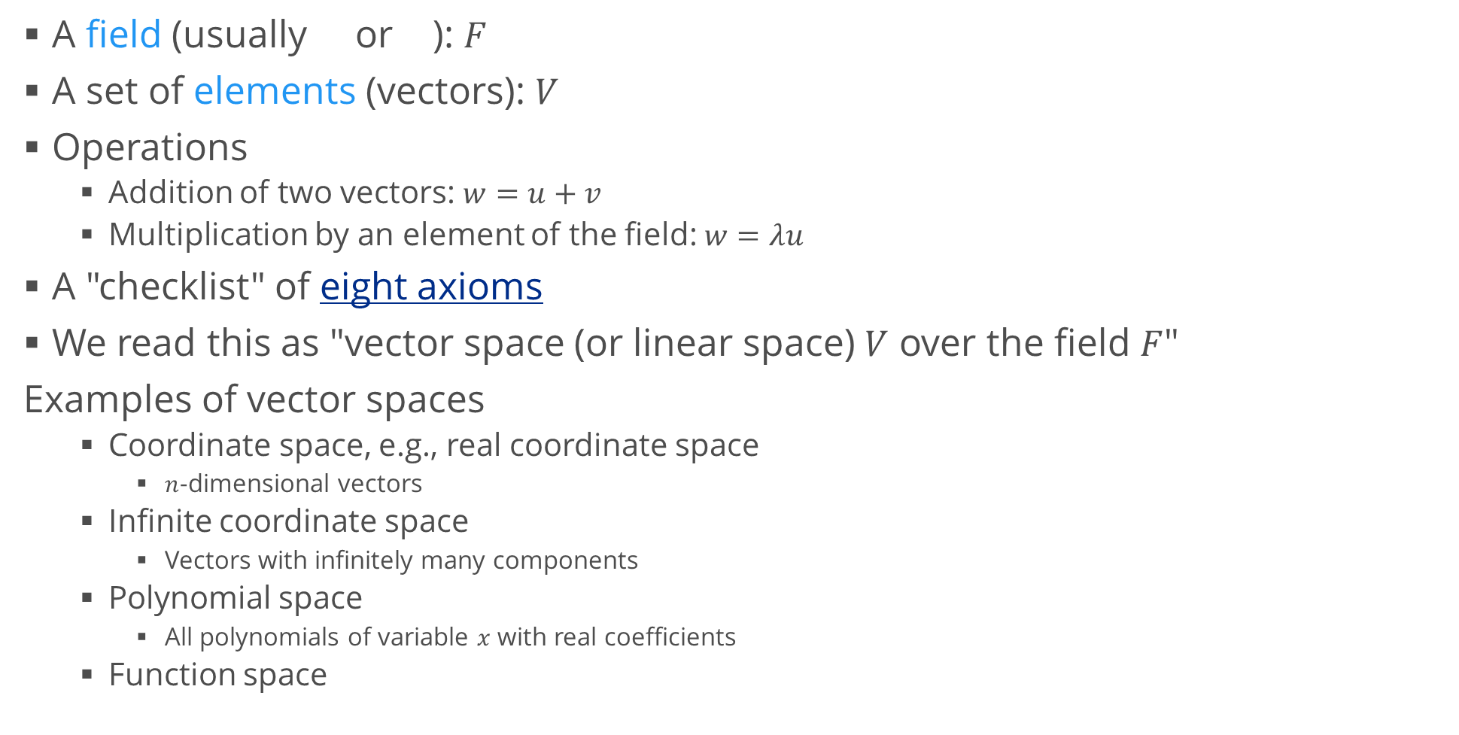
Vector Space
A field (usually or ): $F$
A set of elements (vectors): $V$
Operations
Addition of two vectors: $w=u+v$
Multiplication by an element of the field: $w=λu$
A "checklist" of eight axioms
We read this as "vector space (or linear space) $V$ over the field $F$"
Examples of vector spaces
Coordinate space, e.g., real coordinate space
$n$-dimensional vectors
Infinite coordinate space
Vectors with infinitely many components
Polynomial space
All polynomials of variable $x$ with real coefficients
Function space

Slide 11
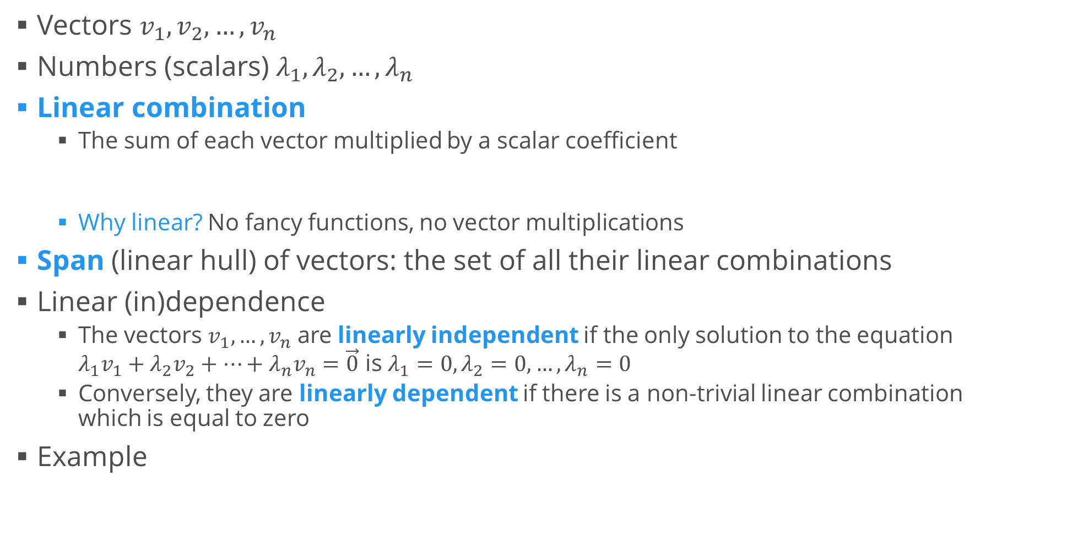
Linear Combinations
Vectors $v_{1},v_{2},…, v_{n}$
Numbers (scalars) $λ_{1},λ_{2},…,λ_{n}$
Linear combination
The sum of each vector multiplied by a scalar coefficient
Why linear? No fancy functions, no vector multiplications
Span (linear hull) of vectors: the set of all their linear combinations
Linear (in)dependence
The vectors $v_{1},…,v_{n}$ are linearly independent if the only solution to the equation $λ_{1}v_{1}+λ_{2}v_{2}+⋯+λ_{n}v_{n}=\vec{0}$ is $λ_{1}=0, λ_{2}=0, …,λ_{n}=0$
Conversely, they are linearly dependent if there is a non-trivial linear combination which is equal to zero
Example

Slide 12
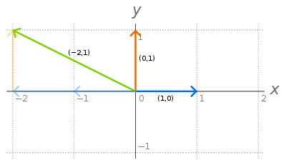
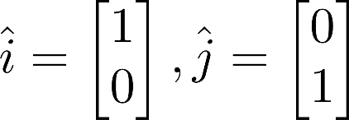
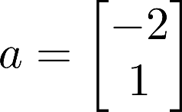

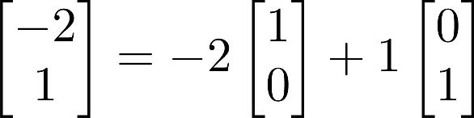
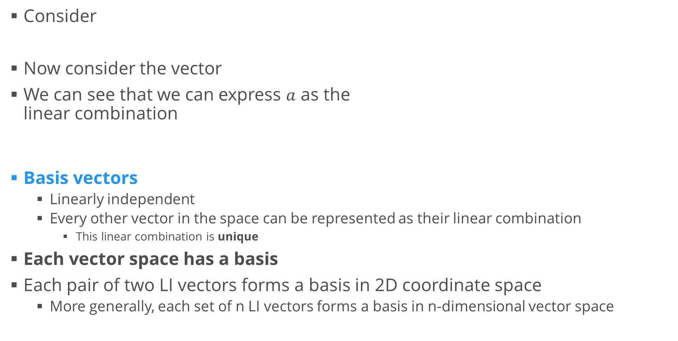
Basis Vectors
Consider
Now consider the vector
We can see that we can express $a$ as the linear combination
Basis vectors
Linearly independent
Every other vector in the space can be represented as their linear combination
This linear combination is unique
Each vector space has a basis
Each pair of two LI vectors forms a basis in 2D coordinate space
More generally, each set of n LI vectors forms a basis in n-dimensional vector space

Slide 13

Matrices
Which pill are you going to take?

Slide 14
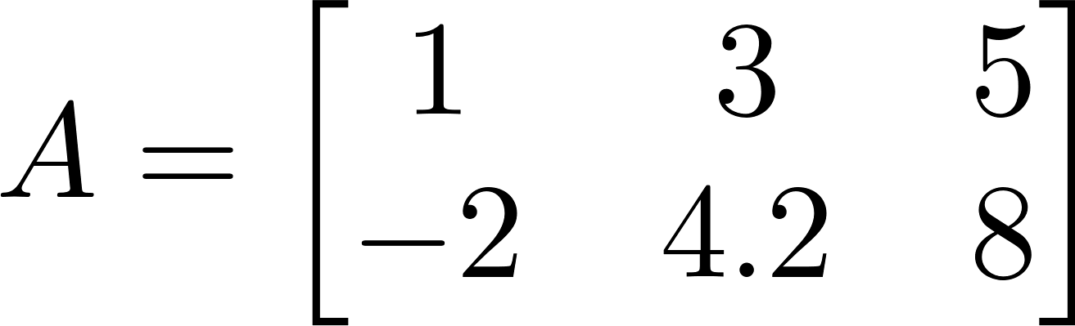
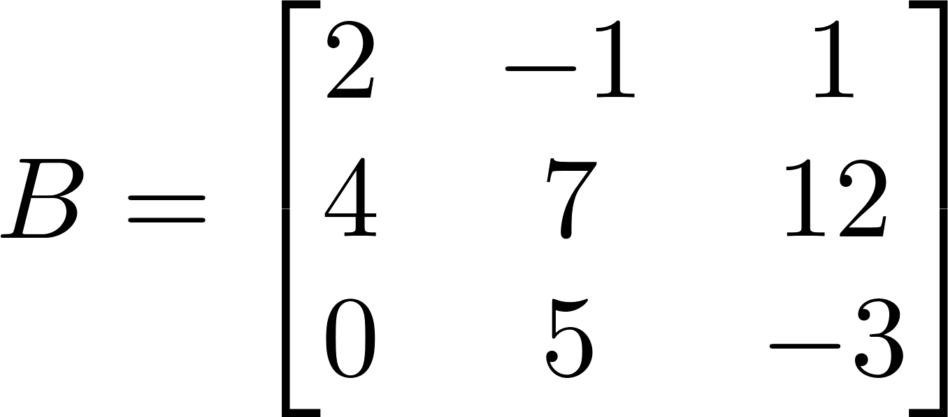
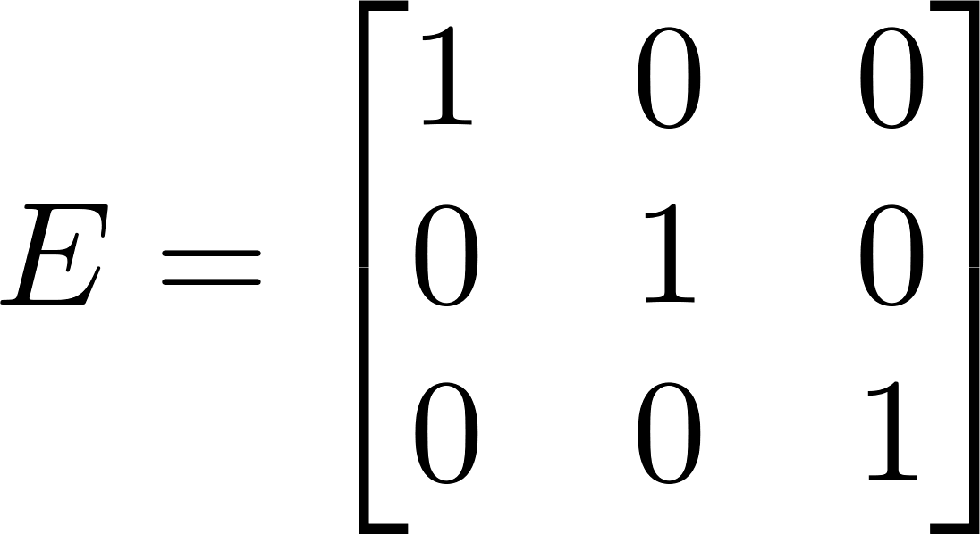
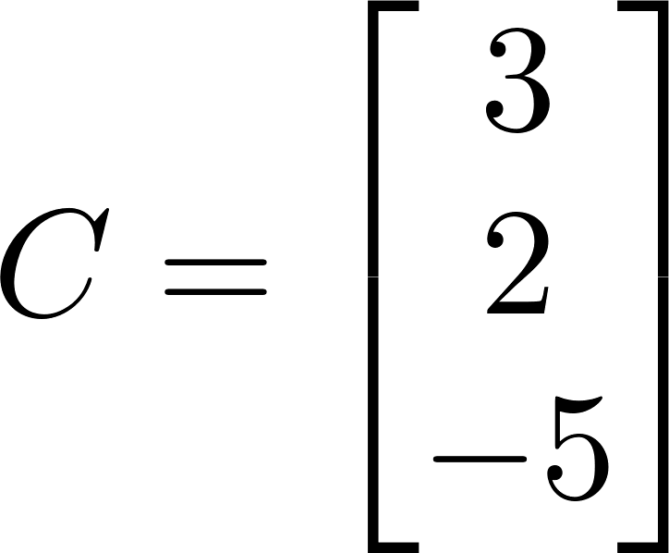
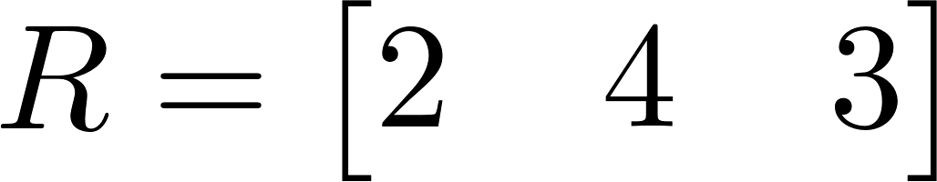
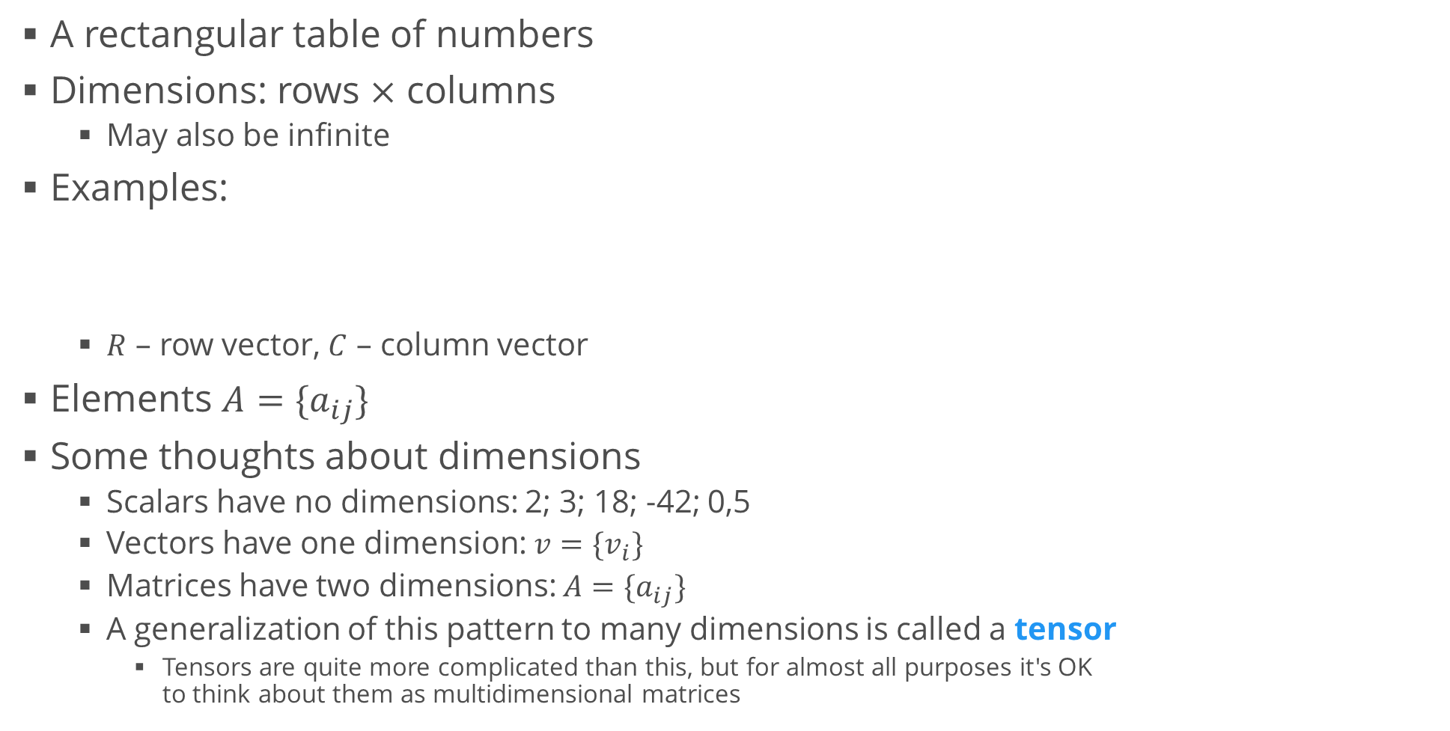
Matrix
A rectangular table of numbers
Dimensions: rows $×$ columns
May also be infinite
Examples:
$R$ – row vector, $C$ – column vector
Elements $A=\{a_{ij}\}$
Some thoughts about dimensions
Scalars have no dimensions: 2; 3; 18; -42; 0,5
Vectors have one dimension: $v={\{v}_{i}\}$
Matrices have two dimensions: $A=\{a_{ij}\}$
A generalization of this pattern to many dimensions is called a tensor
Tensors are quite more complicated than this, but for almost all purposes it's OK to think about them as multidimensional matrices

Slide 15
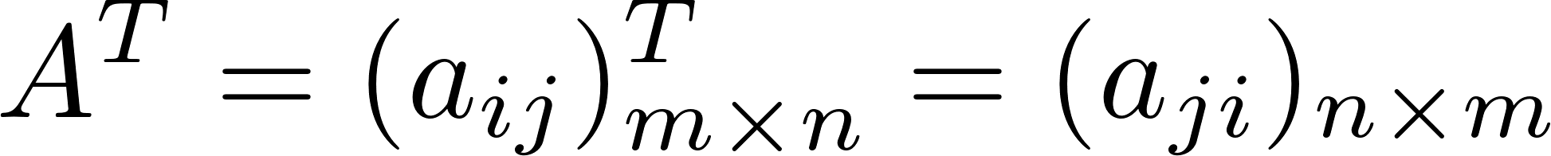
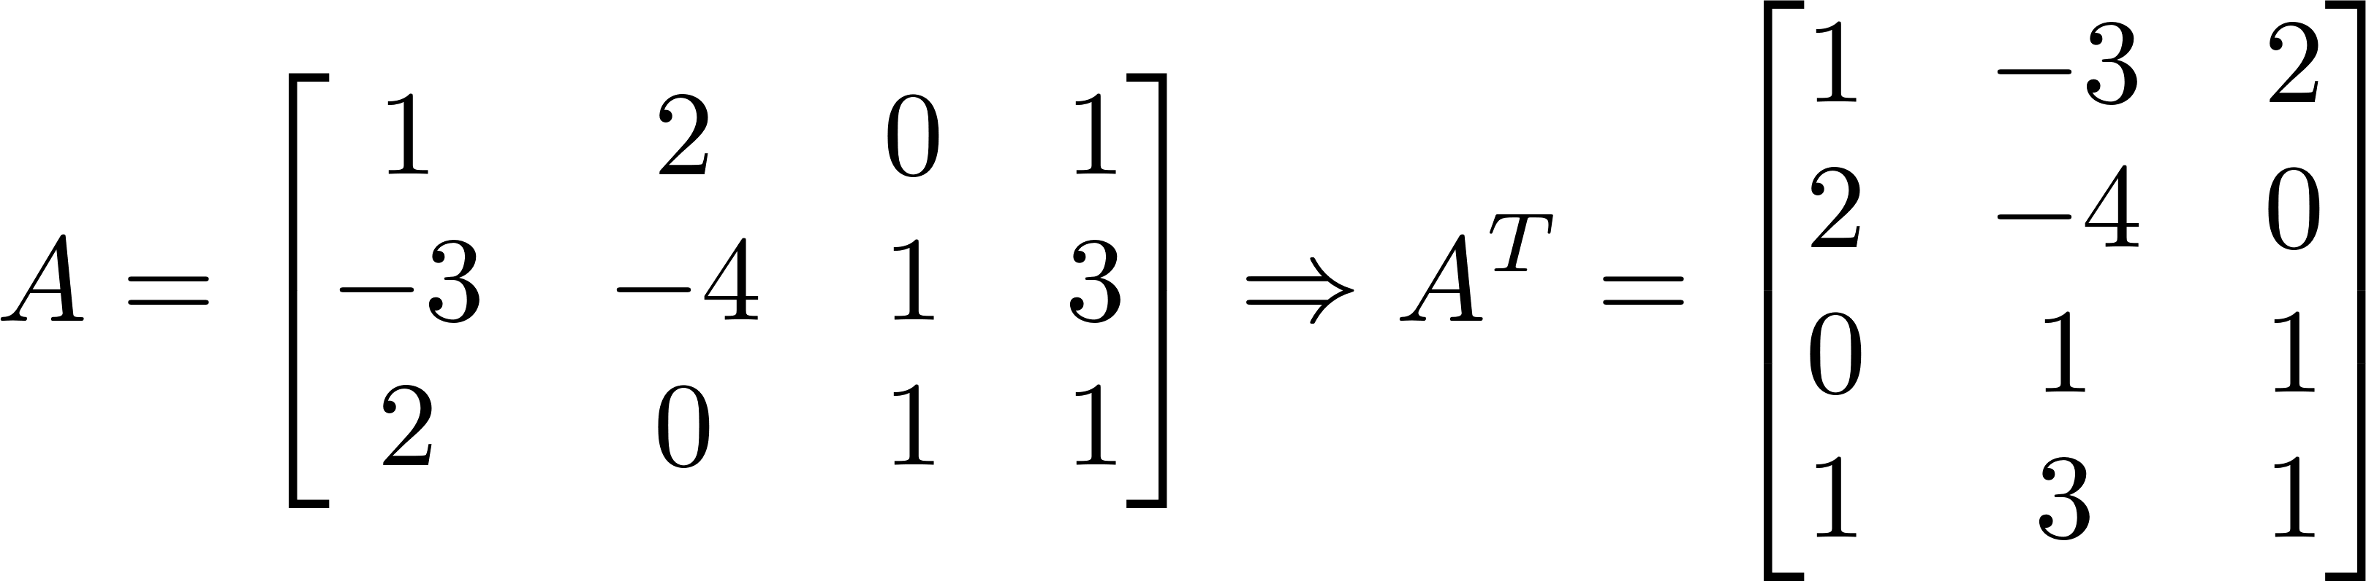

Matrix Operations
Addition (the dimensions must be the same)
Multiplication by a scalar
All $m×n$ matrices form a vector space
Transposition: turning rows into columns and vice versa
The transpose of a matrix is denoted by an upper index T

Slide 16

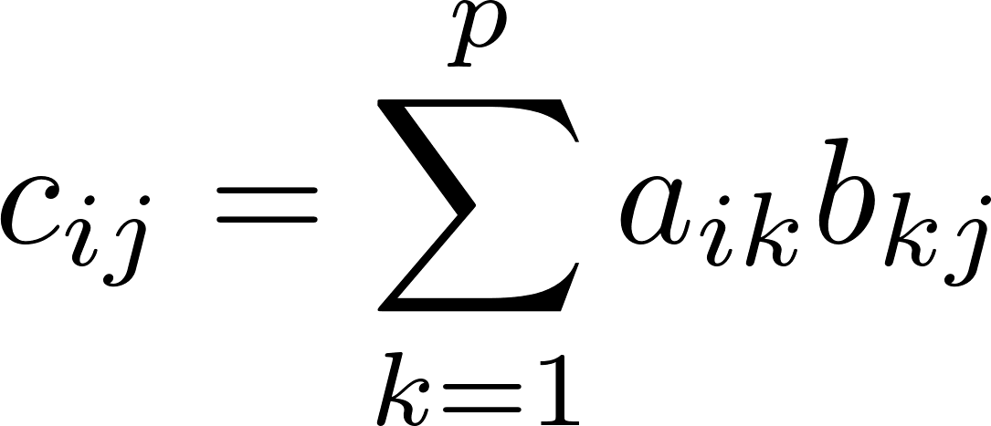
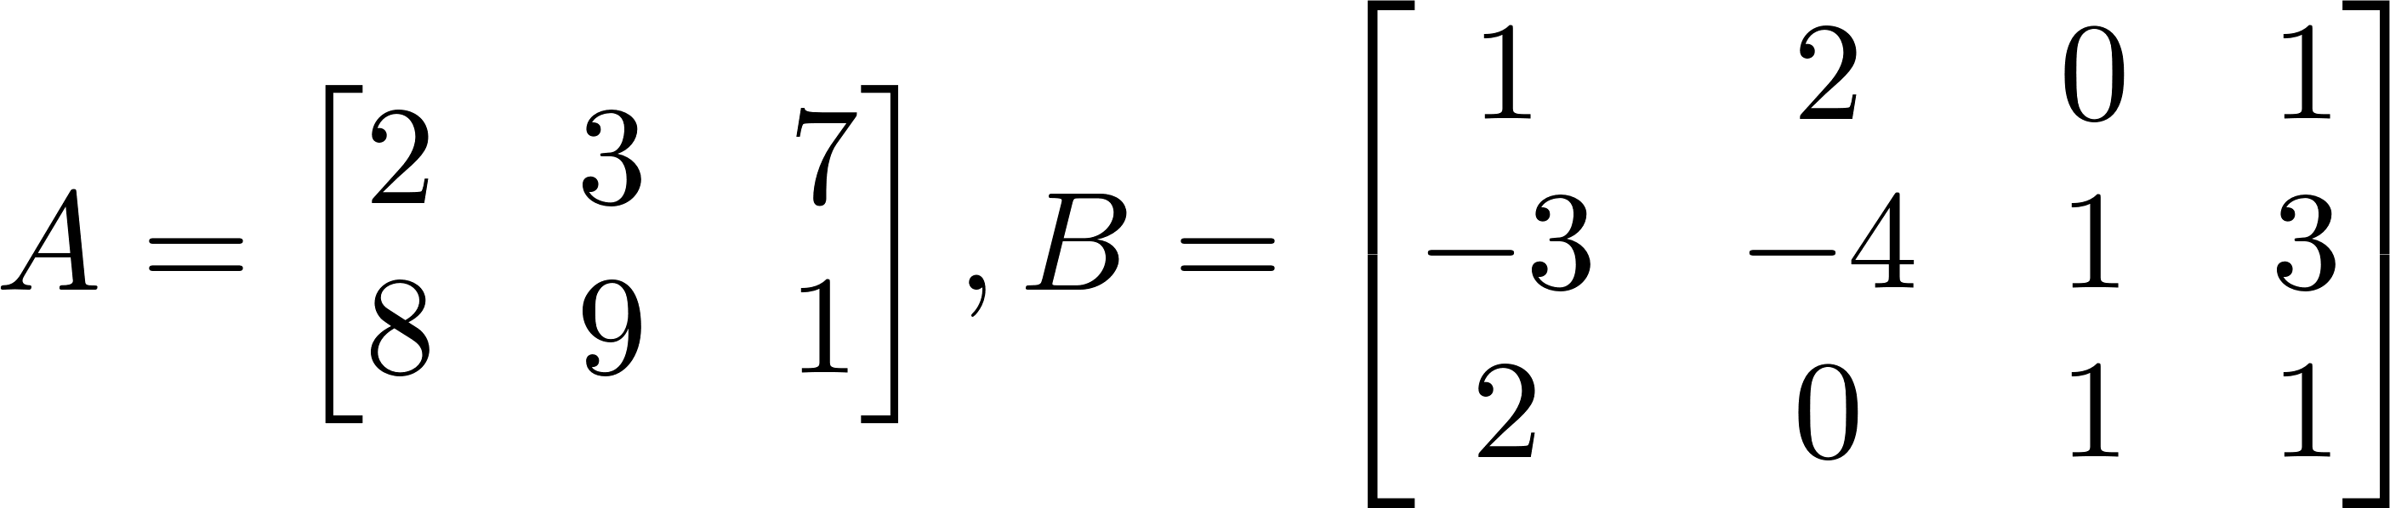
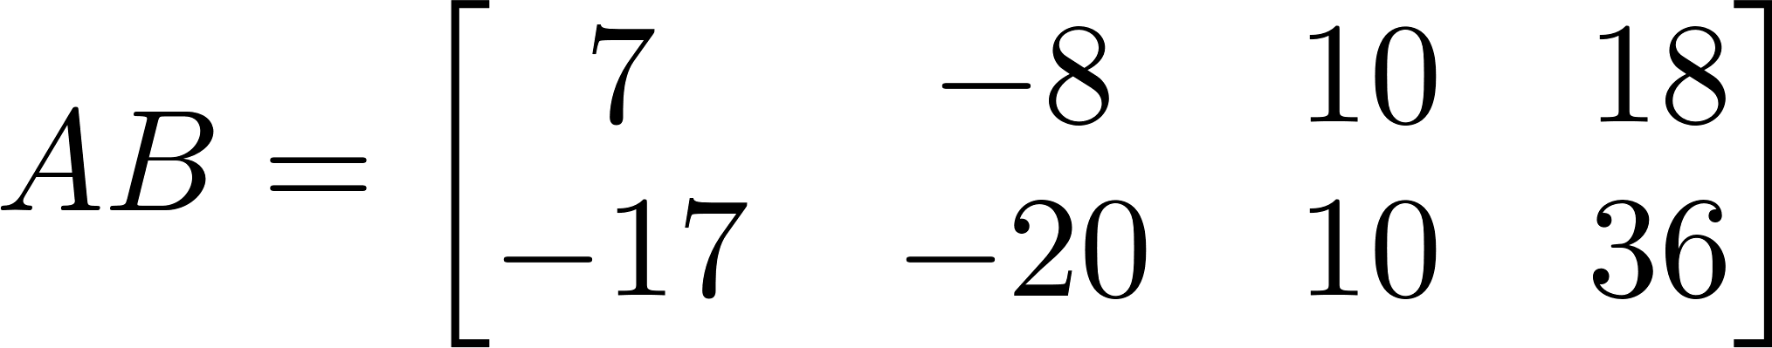
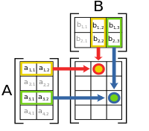

Matrix Multiplication
The dimensions must match:
"Inner dimensions" are the same; result has "outer dimensions"
Definition:
Example
Note that $AB≠BA$
In this case, we can't even multiply $BA$
We say that matrix multiplication is not commutative
Compare with multiplication of numbers: 5.3 = 3.5 $→$ commutative

Slide 17
Matrix Operations in numpy
In numpy we can use dot() for matrix multiplication and dot products
Note: Whenever possible, use numpy arrays instead of Python lists
They perform much faster
They make the code a lot cleaner
A = np.array([
[2, 3, 7],
[8, 9, 1]
])
B = np.array([
[1, -3, 0],
[2, -4, 1]
]) print(A + B)
print(2 * A)
print(A * B) # Element-wise multiplication
print(A.dot(B)) # Error: incompatible dimensions
print(A.dot(B.T)) # Matrix multiplication

Slide 18
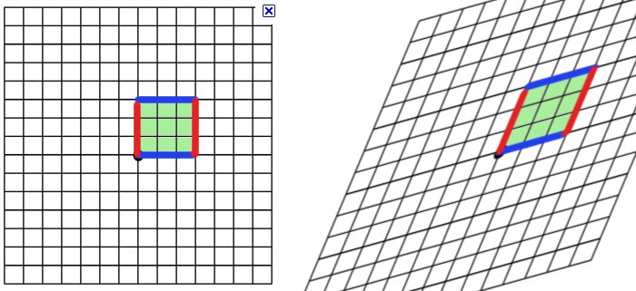
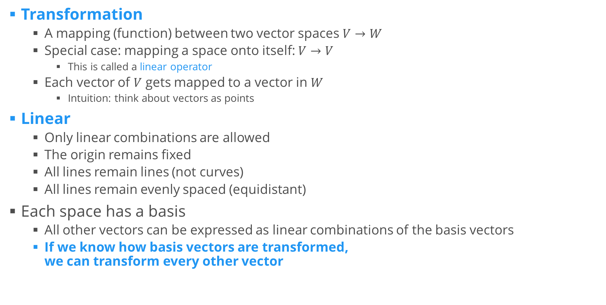
Linear Transformations
Transformation
A mapping (function) between two vector spaces $V→W$
Special case: mapping a space onto itself: $V→V$
This is called a linear operator
Each vector of $V$ gets mapped to a vector in $W$
Intuition: think about vectors as points
Linear
Only linear combinations are allowed
The origin remains fixed
All lines remain lines (not curves)
All lines remain evenly spaced (equidistant)
Each space has a basis
All other vectors can be expressed as linear combinations of the basis vectors
If we know how basis vectors are transformed, we can transform every other vector

Slide 19
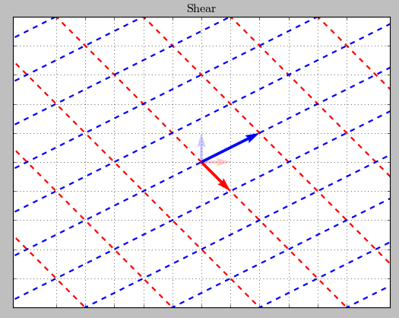
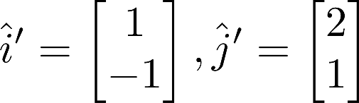
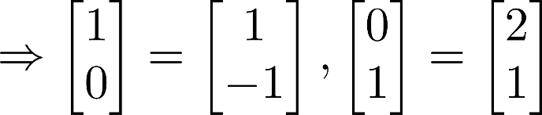

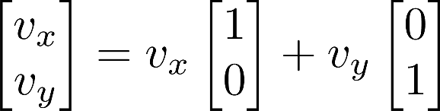

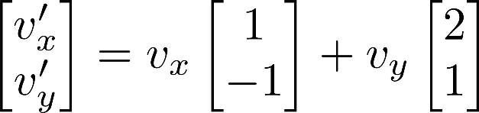
Linear Transformations (2)
Consider the transformation
Consider another vector
Old basis:
New basis:
Same coefficients, new basis vectors
This operation is called applying the linear transformation
Note how applying a linear transformation and change of basis are the same

Slide 20
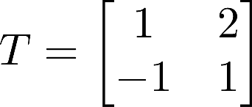

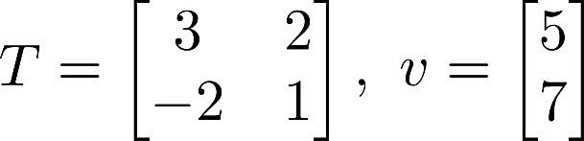
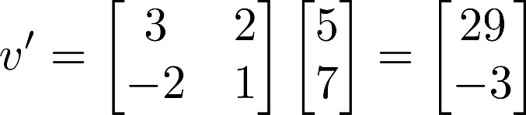
Transformation Matrices
Consider the same transformation
We applied the linear transformation by taking dot products
Therefore, we can describe it in another way – using a matrix
This is called the matrix of the linear transformation
Its columns denote where the basis vectors go
Now, applying the transformation to a vector is the same as multiplying the matrix times the original vector (in that order!)
Example:

Slide 21
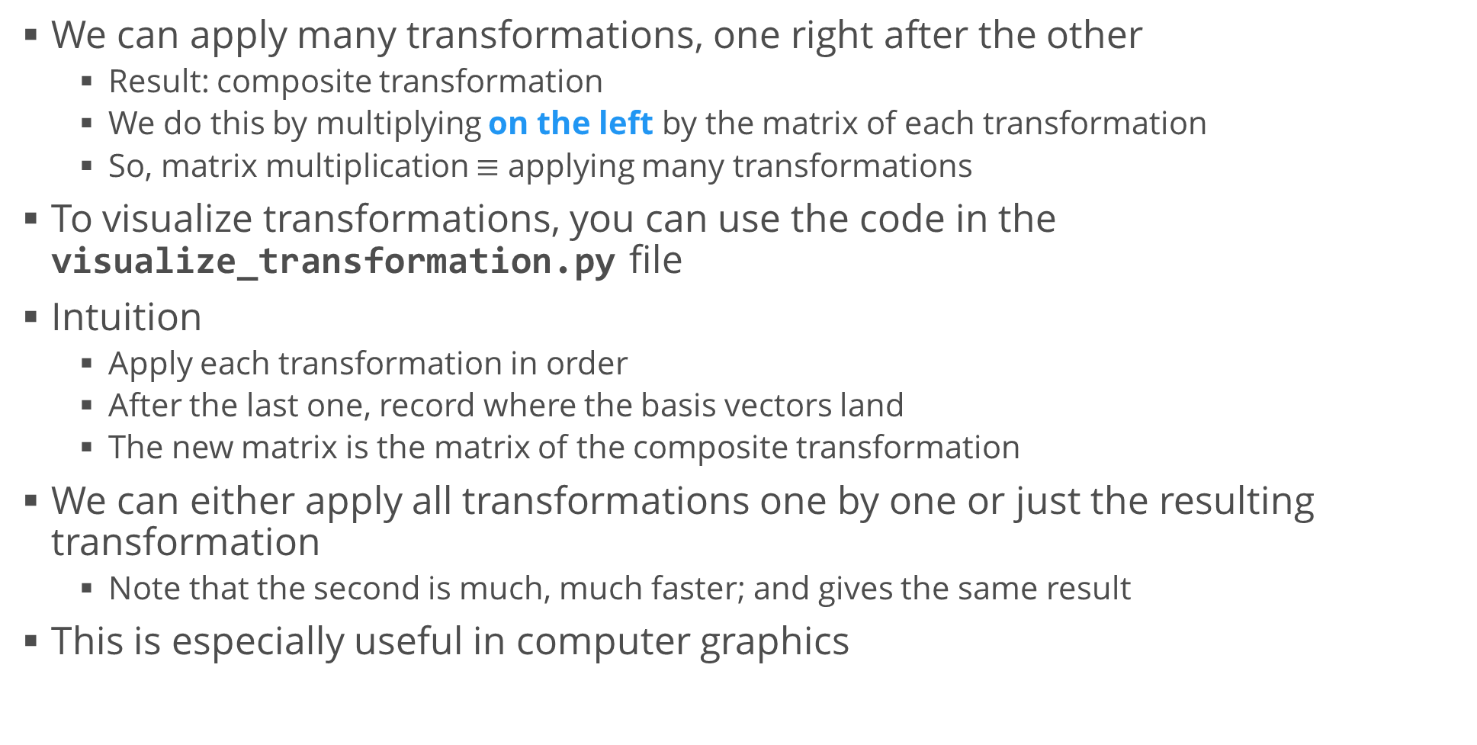
Multiple Transformations
We can apply many transformations, one right after the other
Result: composite transformation
We do this by multiplying on the left by the matrix of each transformation
So, matrix multiplication $≡$ applying many transformations
To visualize transformations, you can use the code in the visualize_transformation.py file
Intuition
Apply each transformation in order
After the last one, record where the basis vectors land
The new matrix is the matrix of the composite transformation
We can either apply all transformations one by one or just the resulting transformation
Note that the second is much, much faster; and gives the same result
This is especially useful in computer graphics

Slide 22
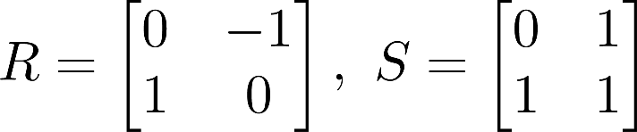
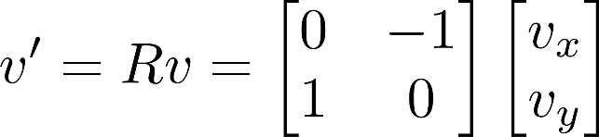
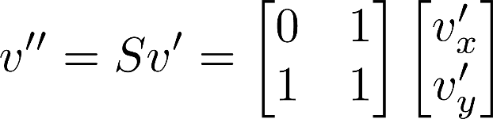
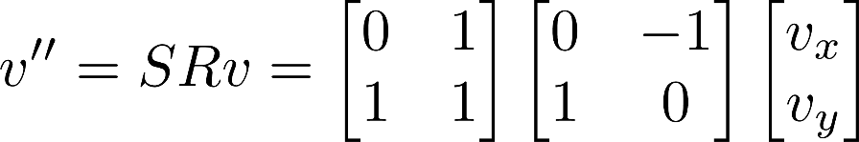

Multiple Transformations (2)
Example: rotation, then shearing
Apply rotation to a vector
Apply shear to the resulting vector
This is the same as
The new transformation matrix is

Slide 23

Determinant
A linear transformation stretches space
Since lines remain parallel and equidistant, space is stretched equally, no matter where we look
A characteristic of the space is "the unit area" – a 1x1 square
The transformation will change this area
Determinant – a measure of how much the unit area changes
Scalar value
Defined only for square matrices
For more than two dimensions, area $→$ volume
The determinant of a matrix $A$ is denoted $\det{(A)}$
Written with straight lines
There are "easy" computational rules for 2D and 3D matrices
Generally, the determinant is given by a formula
The determinant has very useful properties
Especially $\det\left(AB\right)=\det\left(A\right)det⁡(B)$

Slide 24
Linear Systems
… again

Slide 25



Linear Systems in Matrix Form
Consider the linear system
Unknown variables $x,y,z$
We can represent this as a matrix equation
Or more generally, $Ax=b$
Looks like a linear equation "on steroids"
Transformation perspective
The matrix $A$ specifies a transformation
This transformation was applied to ${\left[x y z\right]}^{T}$ to get ${\left[−3 0 2\right]}^{T}$
Can we find the inverse transformation?

Slide 26



Inverse Matrix
Consider a general, "good" transformation
We'll talk later which transformations are not so good
The inverse transformation will "bring back" the basis vectors
E.g., ${90}^{∘}$clockwise rotation $⇒$ ${90}^{∘}$ counterclockwise rotation
The inverse transformation has its own matrix: $T^{−1}$
If we apply the transformation and the inverse, we'll get our initial result
This means, nothing will change
In math terms, $T^{−1}T=E$
Let's now try to apply the inverse transformation to our linear system
Note that this means multiplying on the left

Slide 27

Solving the Linear System
So, to find the unknown vector $x$, we need to find the inverse matrix of $A$ – the matrix of the linear system
How?
There are many methods, the most popular of which is called Gaussian elimination (or Gauss – Jordan method)
We'll see this in the exercises
Basic idea: $A^{−1}A=E$
Apply some transformation to get from $A$ to $E$
Apply the same transformation to $E$
What we get is the inverse matrix
Uses: a lot
Makes solving linear systems very fast and robust
Allows us to solve multiple linear systems with the same coefficients and different "free terms"

Slide 28

How About "Bad" Matrices?
If the determinant of the matrix is zero, every element is mapped into a lower-dimensional space
2D case: $\det{(A)}=0⇒$ every possible point in the 2D space is mapped onto a single vector
We can use the visualization to confirm this
We can also use our intuition: when is the area equal to zero?
Another viewpoint: $\det\left(A\right)=0⇒$ linearly dependent rows
Consequently, there are many points mapped on the same point
Consider projection as an example
No "reversible" (invertible) function maps many inputs to one output
The matrix, therefore, is non-invertible
$A^{−1}$ does not exist!
However, solutions to the matrix can sometimes exist
We found one such solution in the first lecture
We'll talk about this in more detail in the exercises

Slide 29
Summary
Vectors
Geometric and algebraic perspectives
Operations
Matrices
Definition
Properties
Operations
Linear transformations
Linear systems

